Slide 1
NCBI @ TOAST office hours – GenBank submission & sequence errors
April 23rd, 2021 – Linda Yankie & Eric Nawrocki

Slide 2
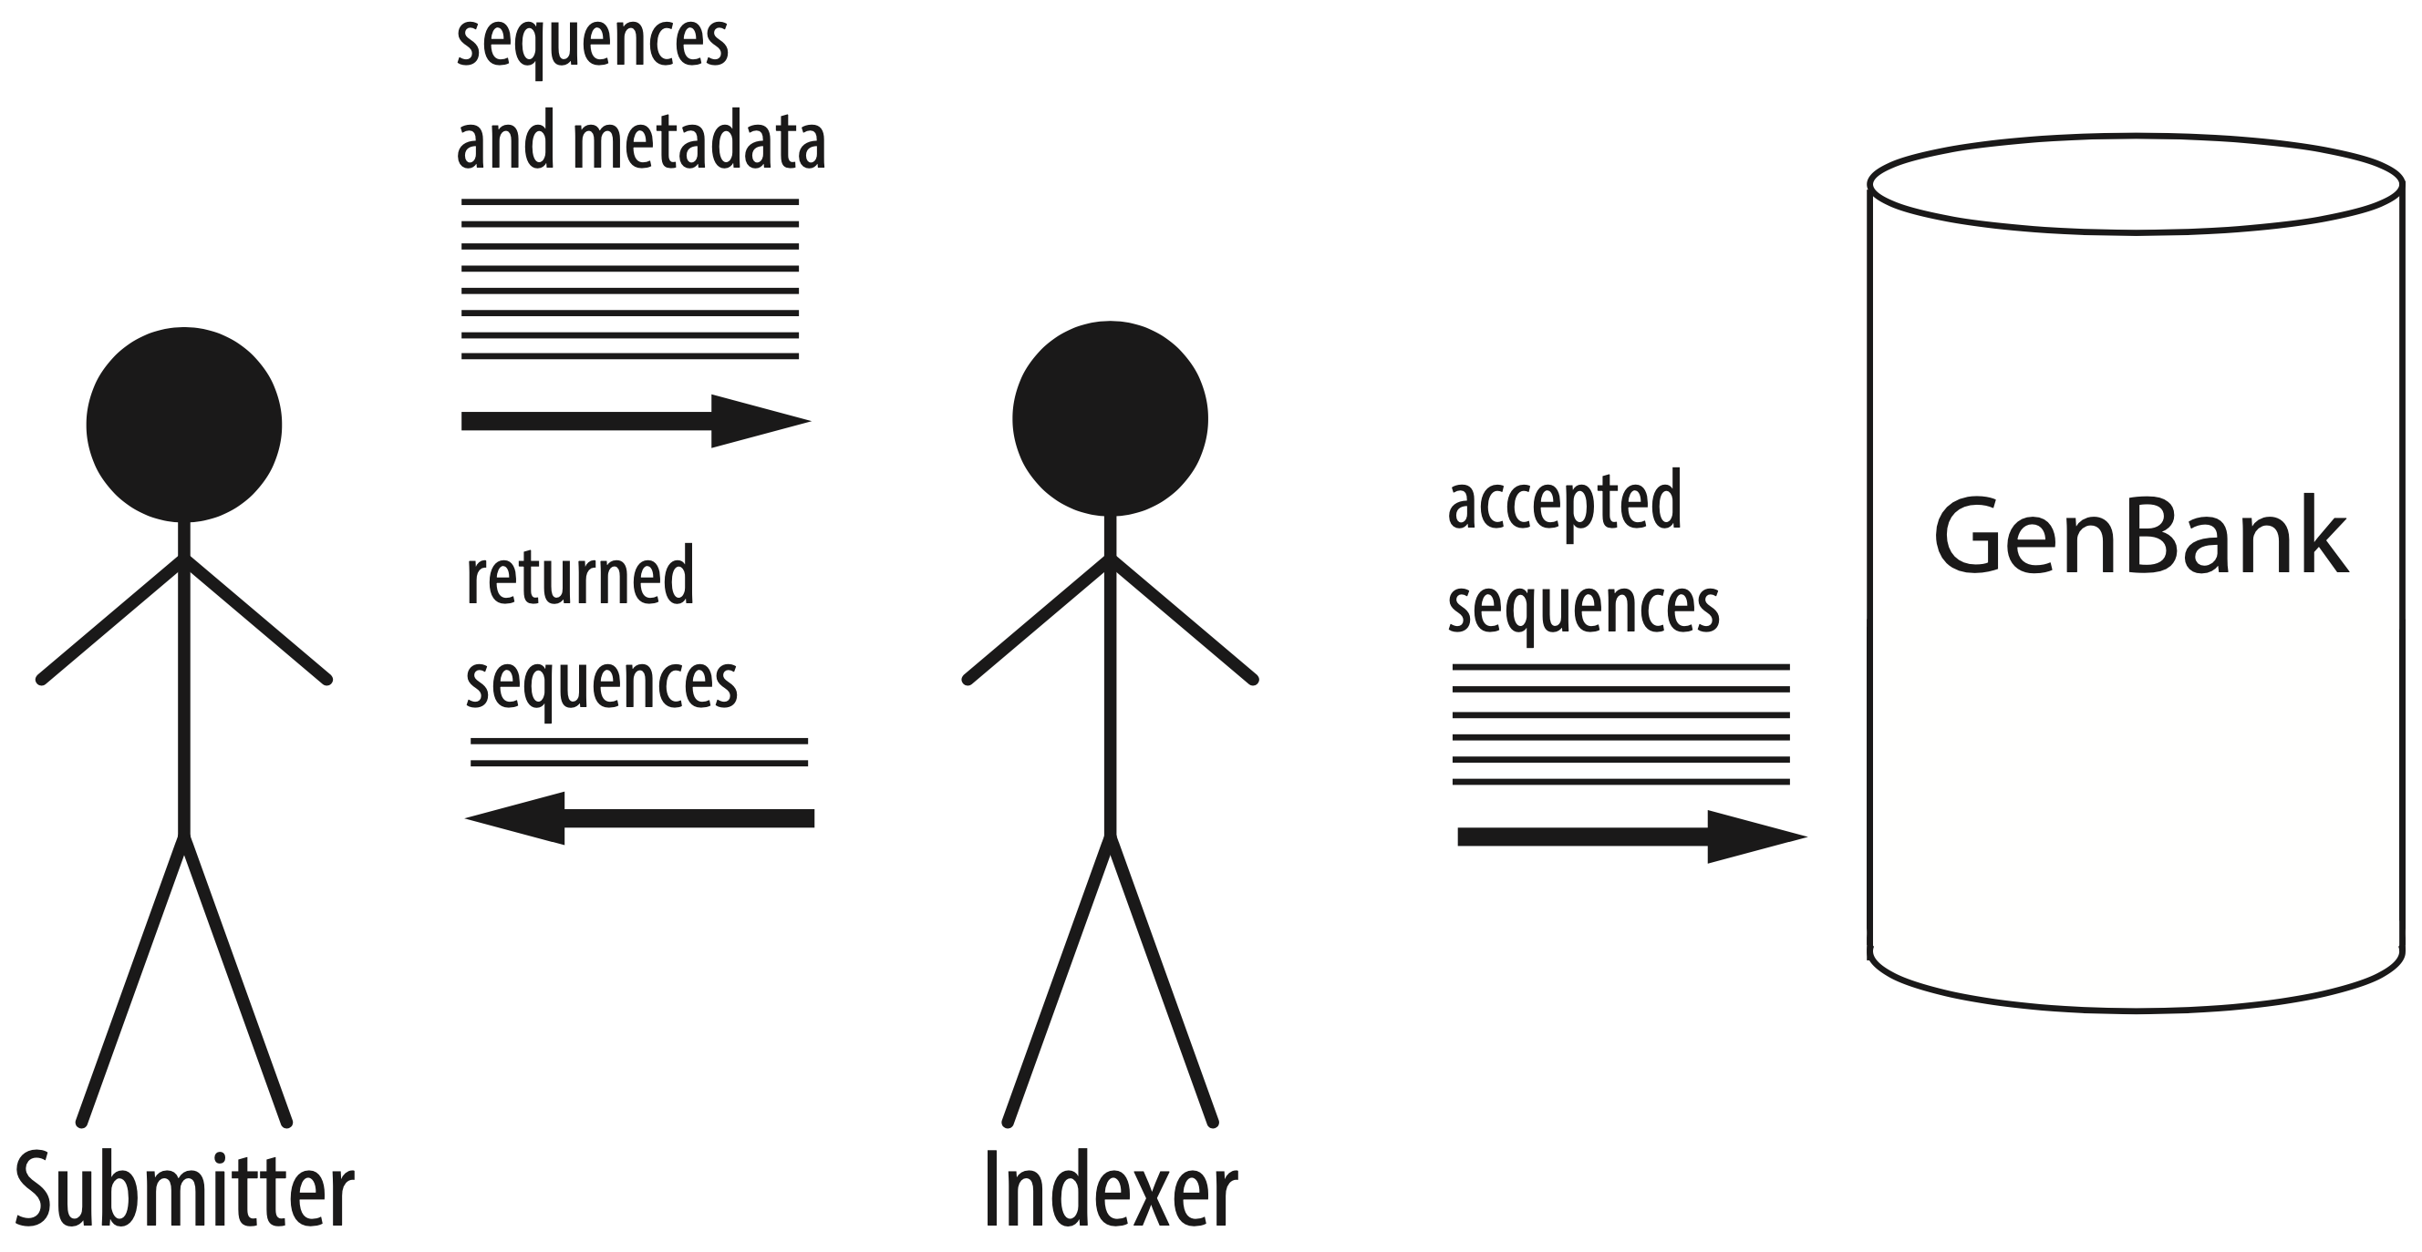
GenBank indexers handle incoming sequence submissions

Slide 3
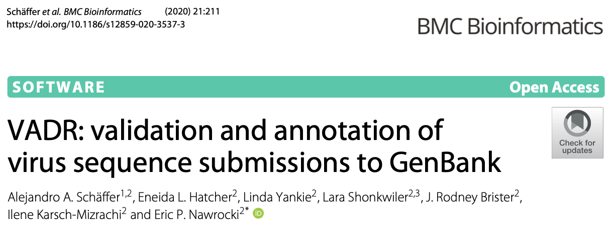
VADR: Viral Annotation DefineR
General tool for reference-based annotation of viral sequences
Originally designed for dengue virus and norovirus but used for SARS-CoV-2 since March 2020

Slide 4
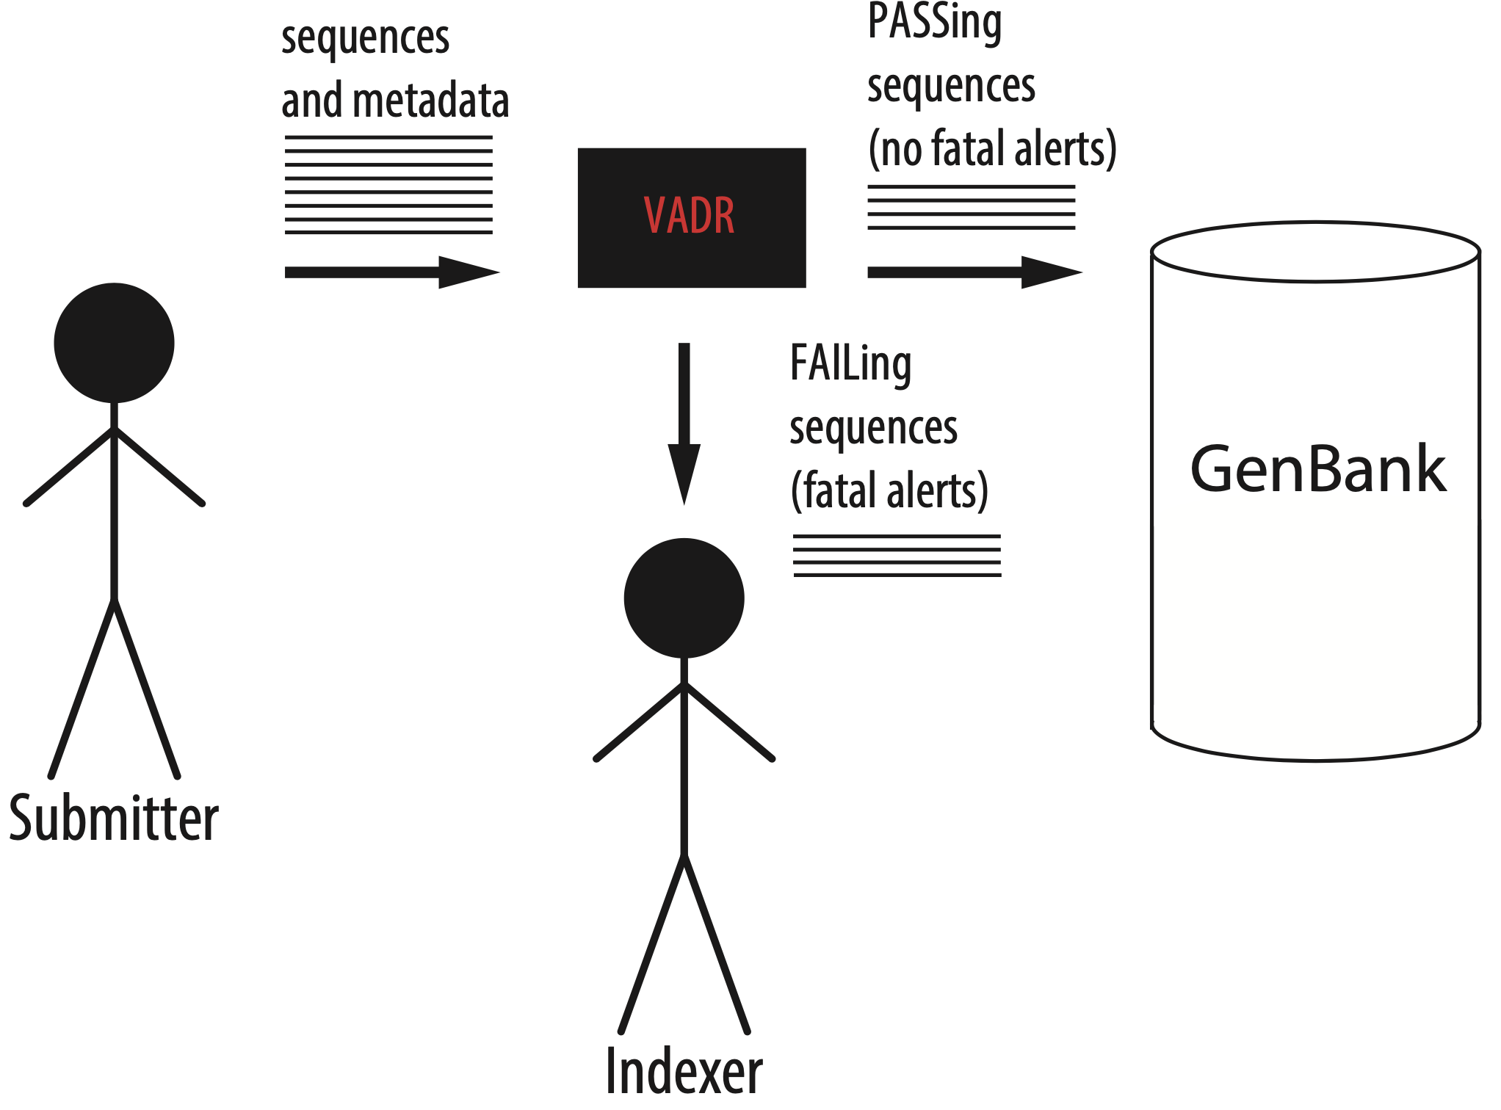
VADR assists GenBank indexers: Each sequence PASSes or FAILs

Slide 5
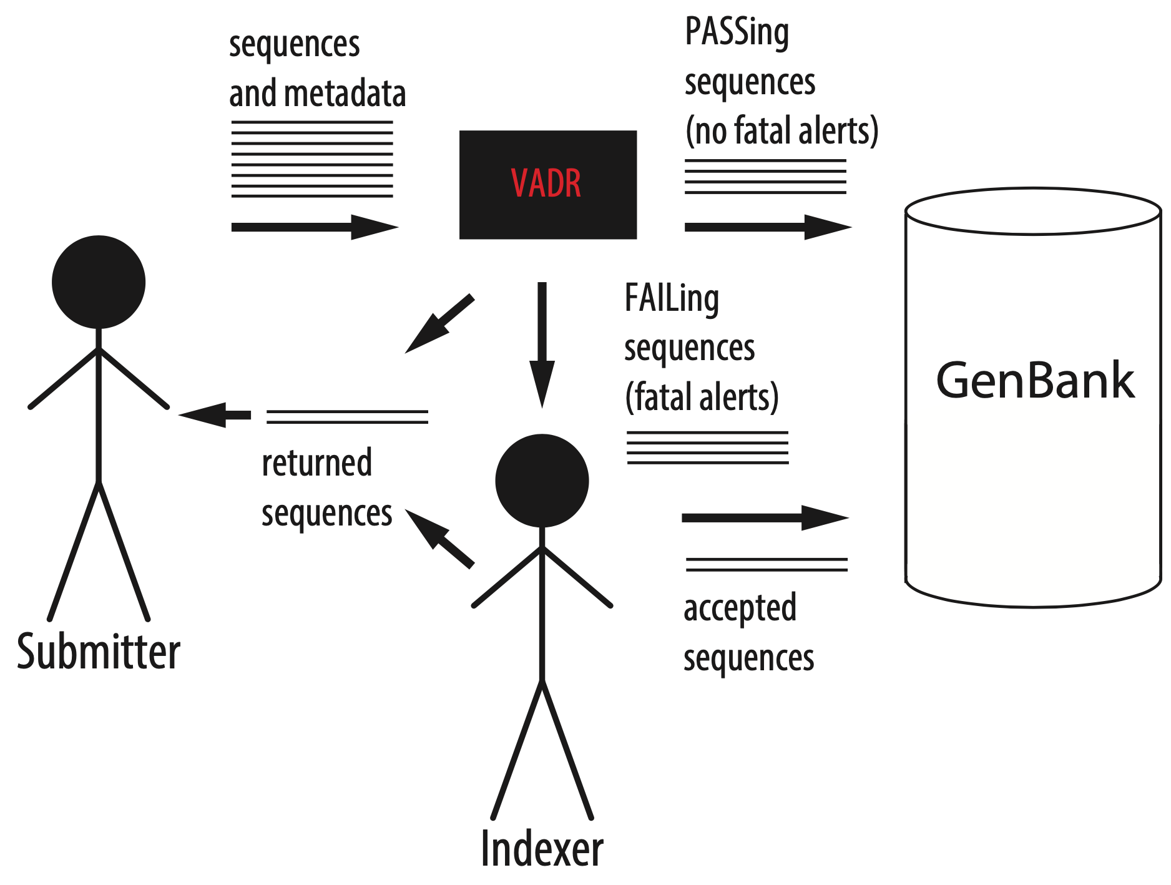
Indexers decide fate of FAILed sequences

Slide 6
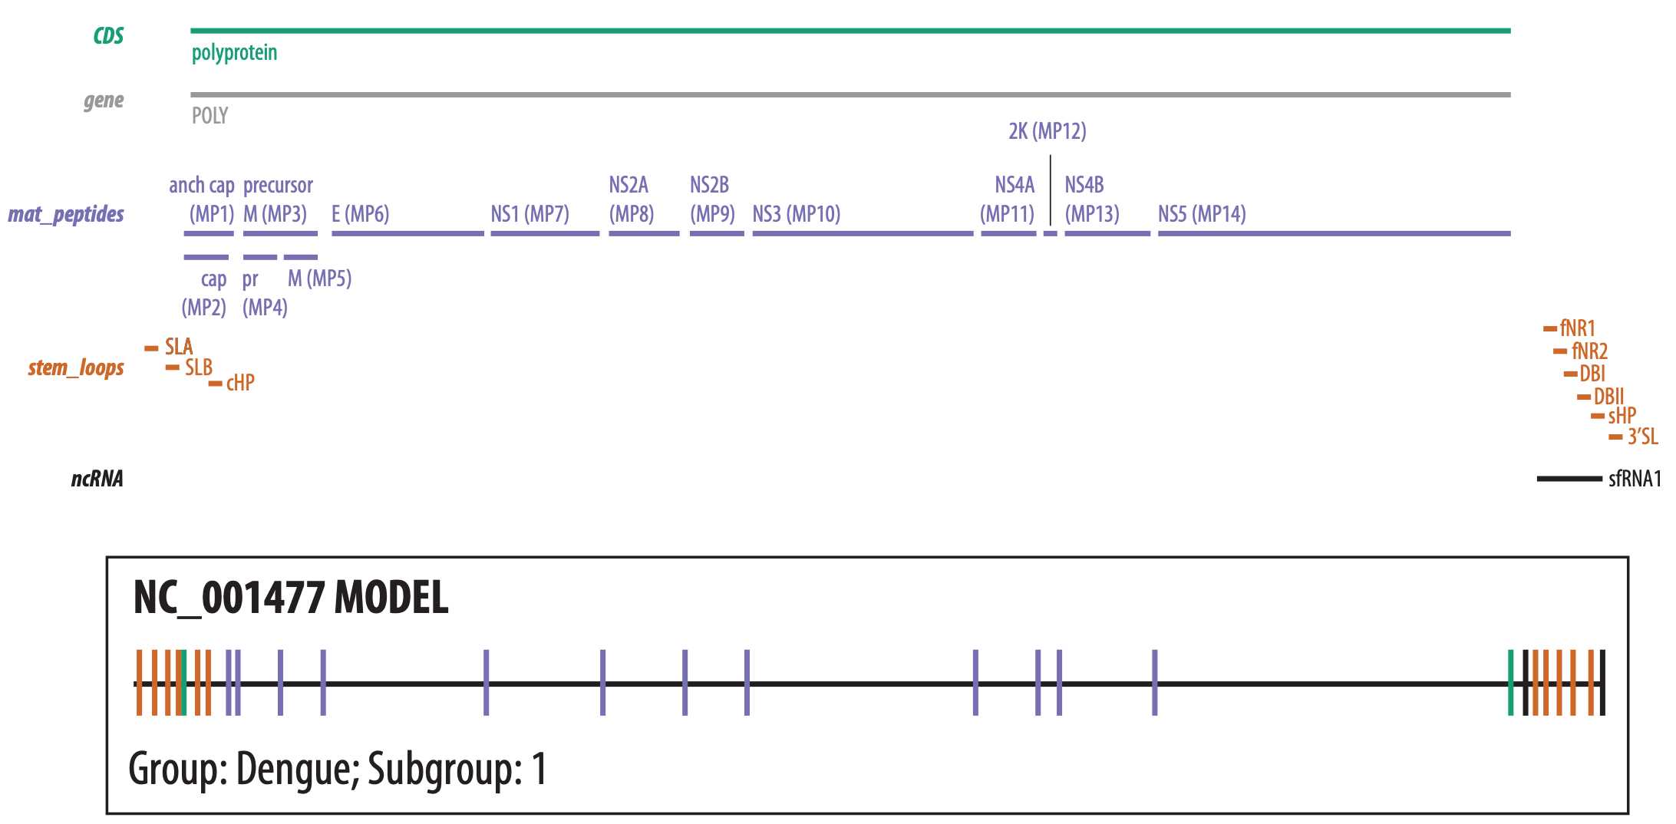
VADR builds a reference model of a RefSeq and its features

Slide 7
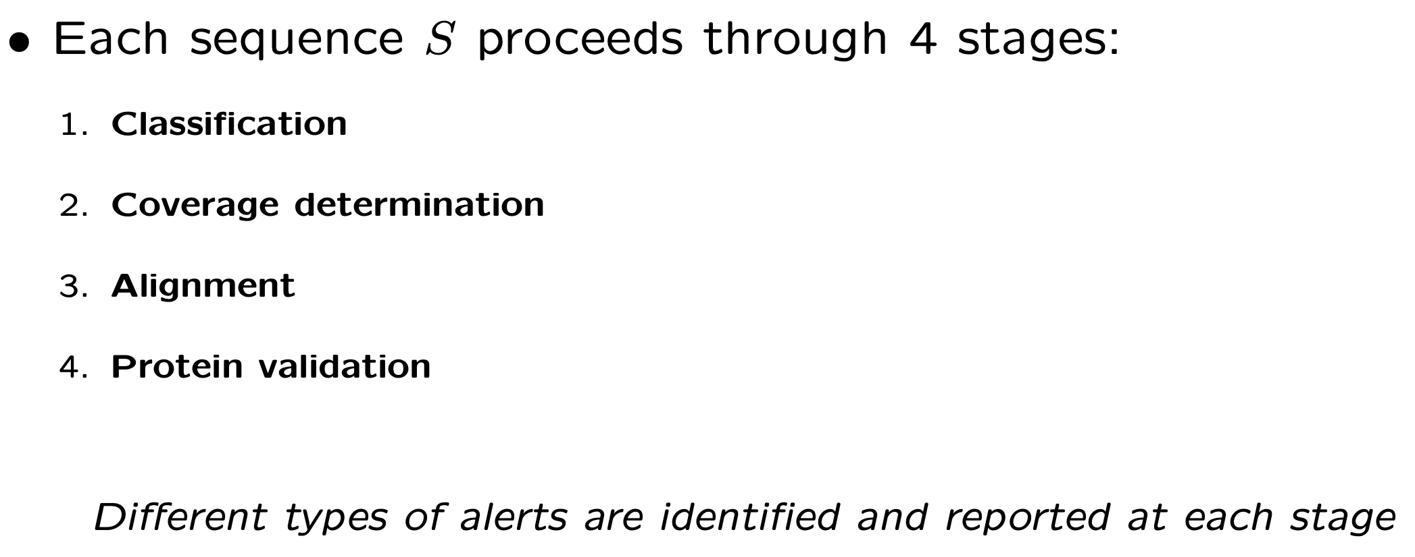
VADR annotates each sequence with features from its best matching model

Slide 8
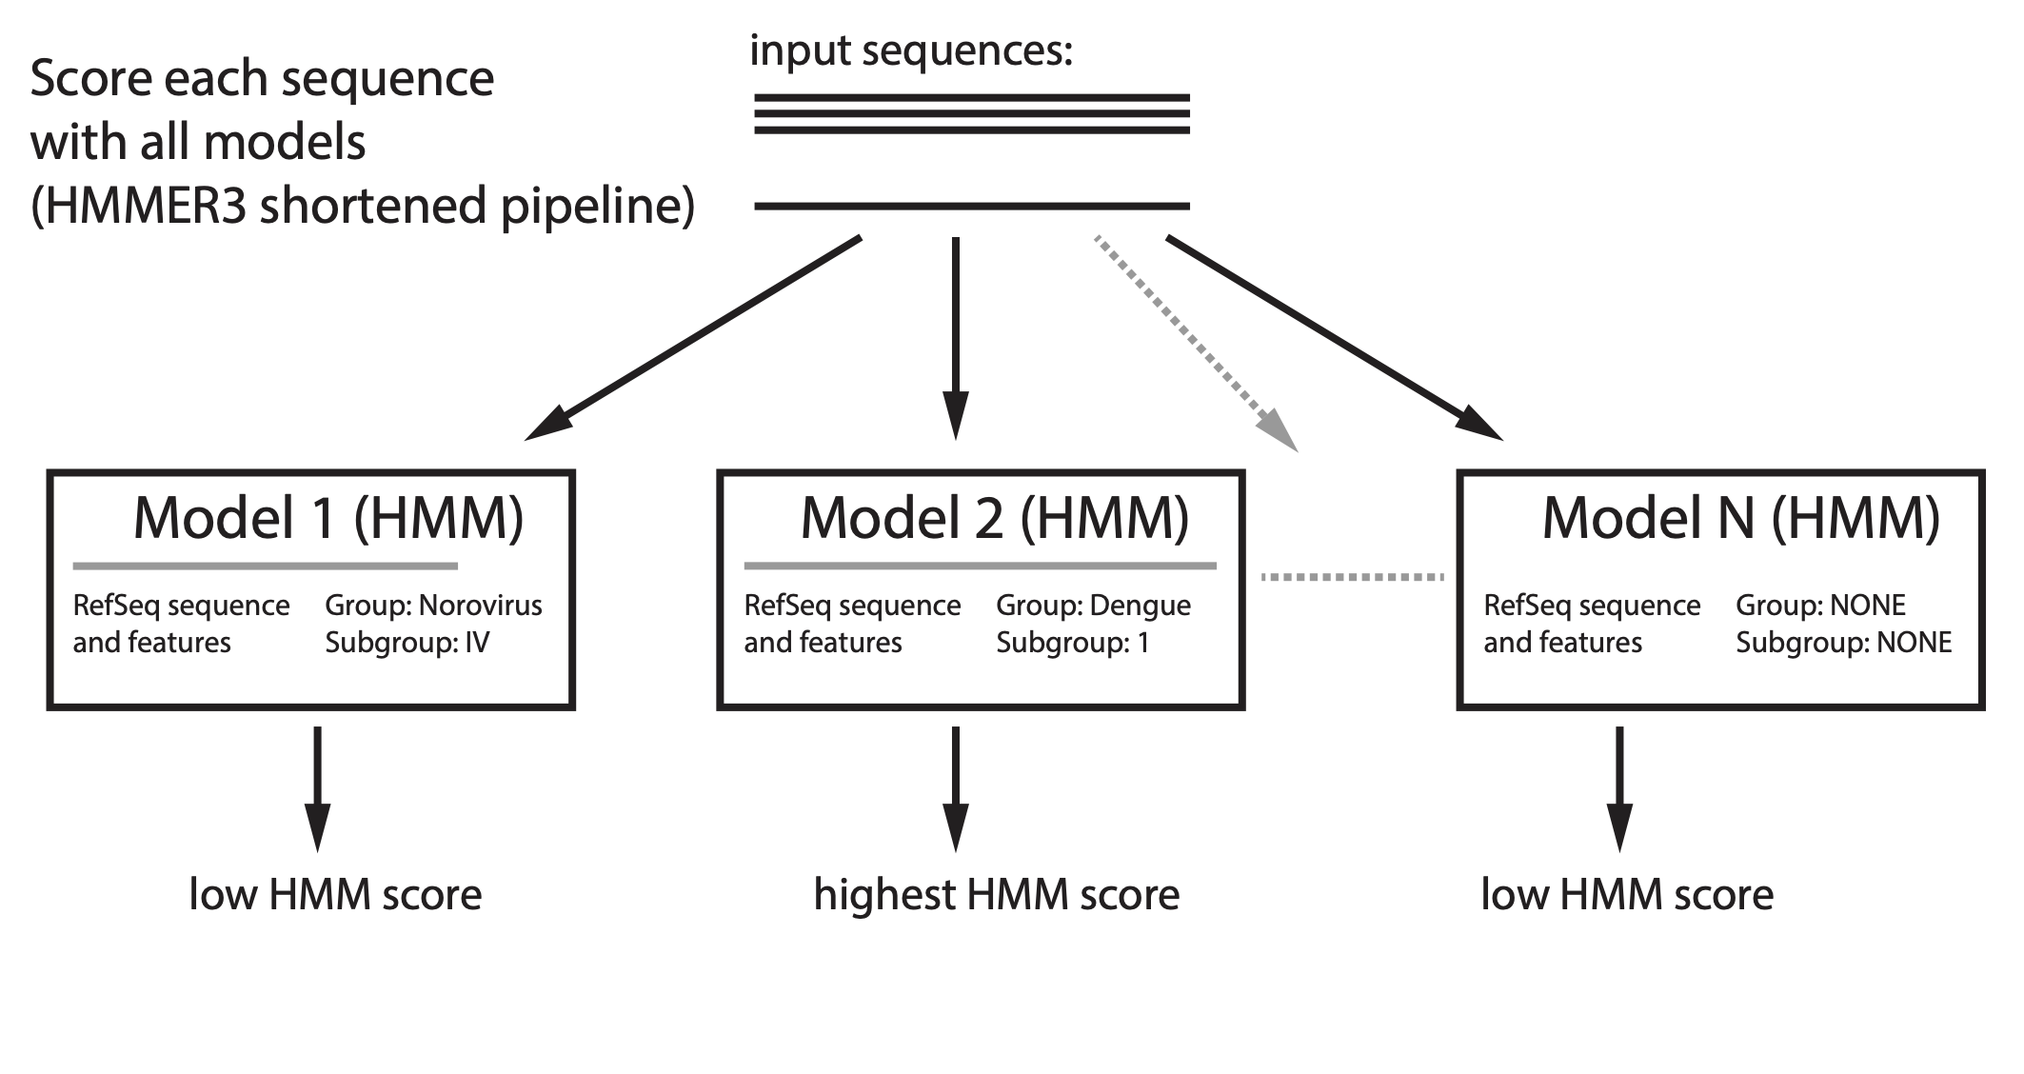
Stage 1: Classification

Slide 9
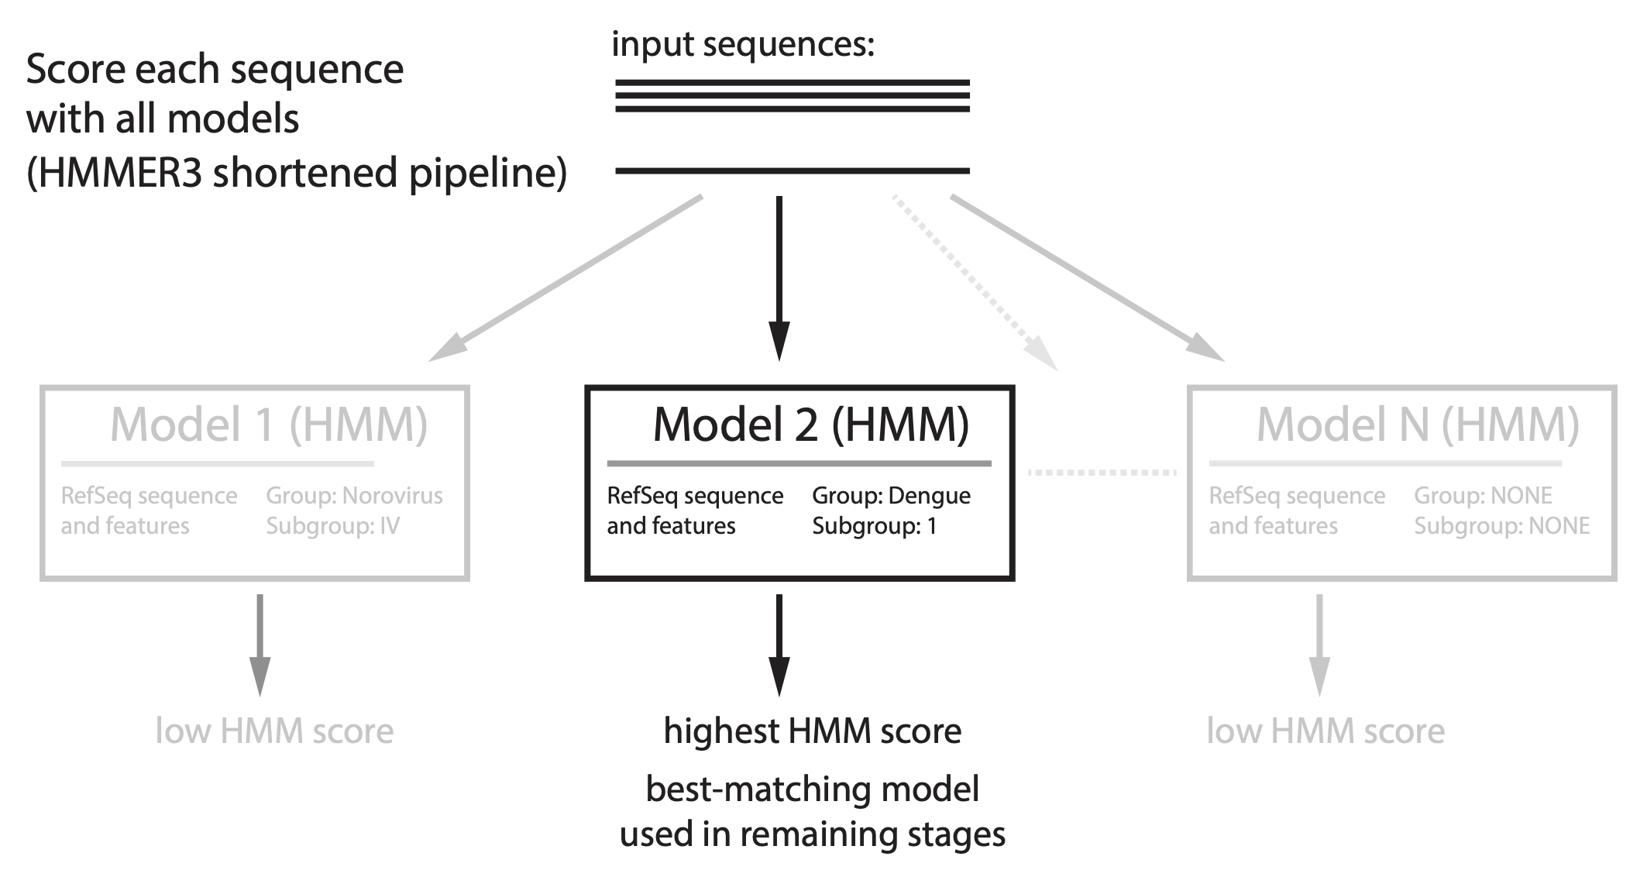
Stage 1: Classification

Slide 10
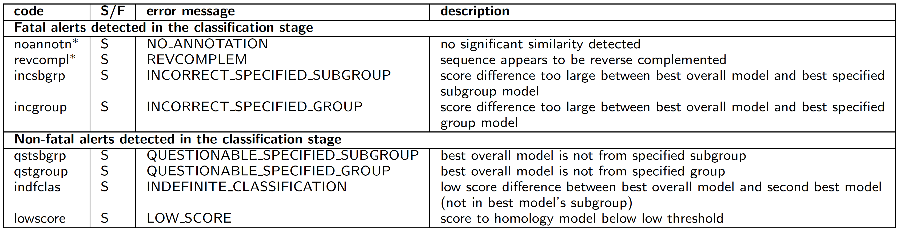
Alerts reported in classification stage

Slide 11
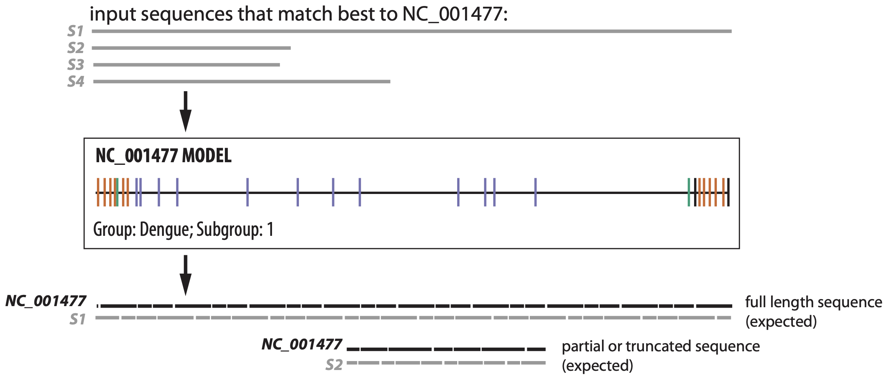
Stage 2: Coverage determination
Search each sequence with best-matching model (HMMER3 full pipeline)

Slide 12
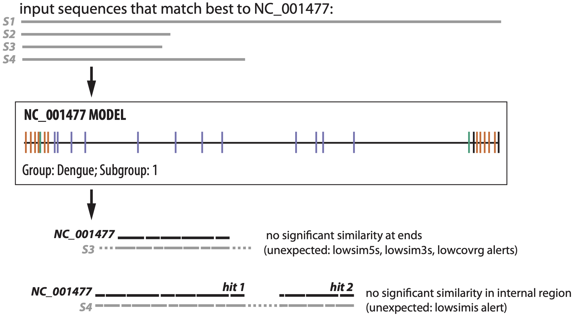
Stage 2: Coverage determination

Slide 13
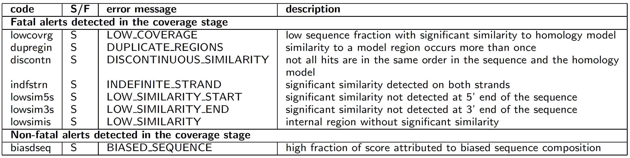
Alerts reported in coverage determination stage

Slide 14
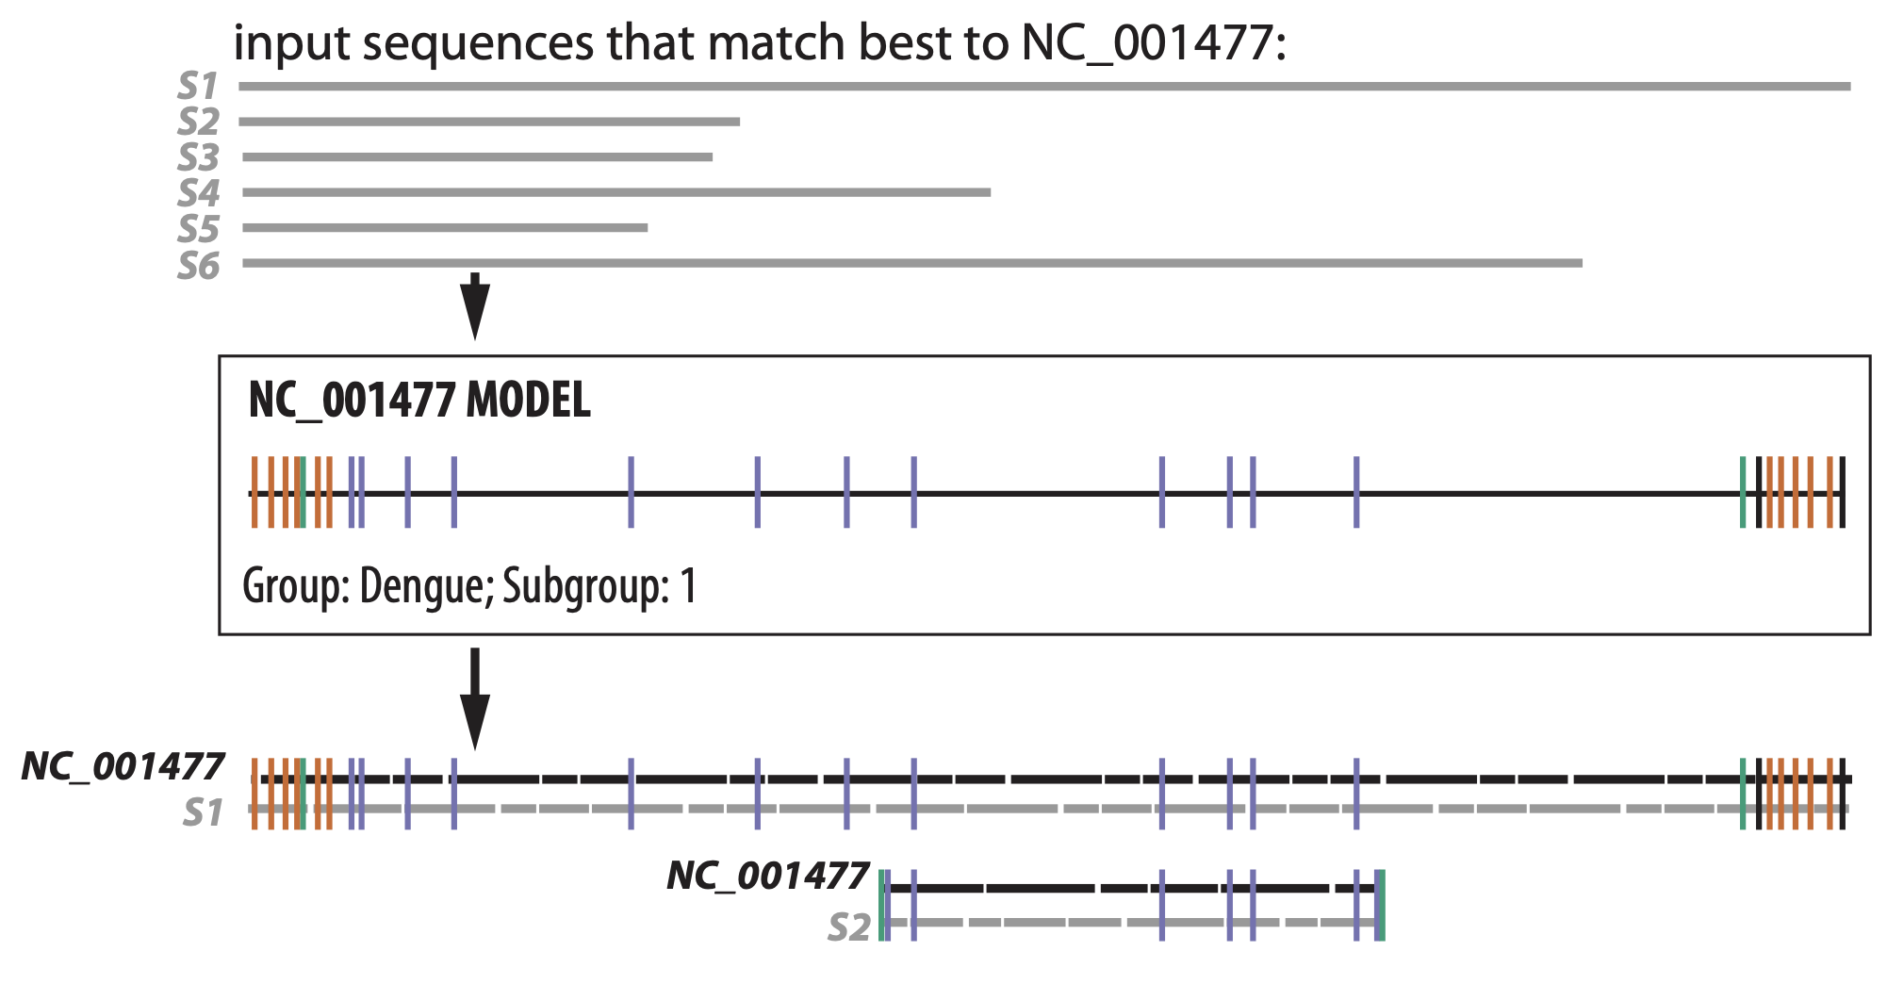
Stage 3: Alignment & feature mapping
Align each sequence to its best-matching model (Infernal's cmalign)

Slide 15
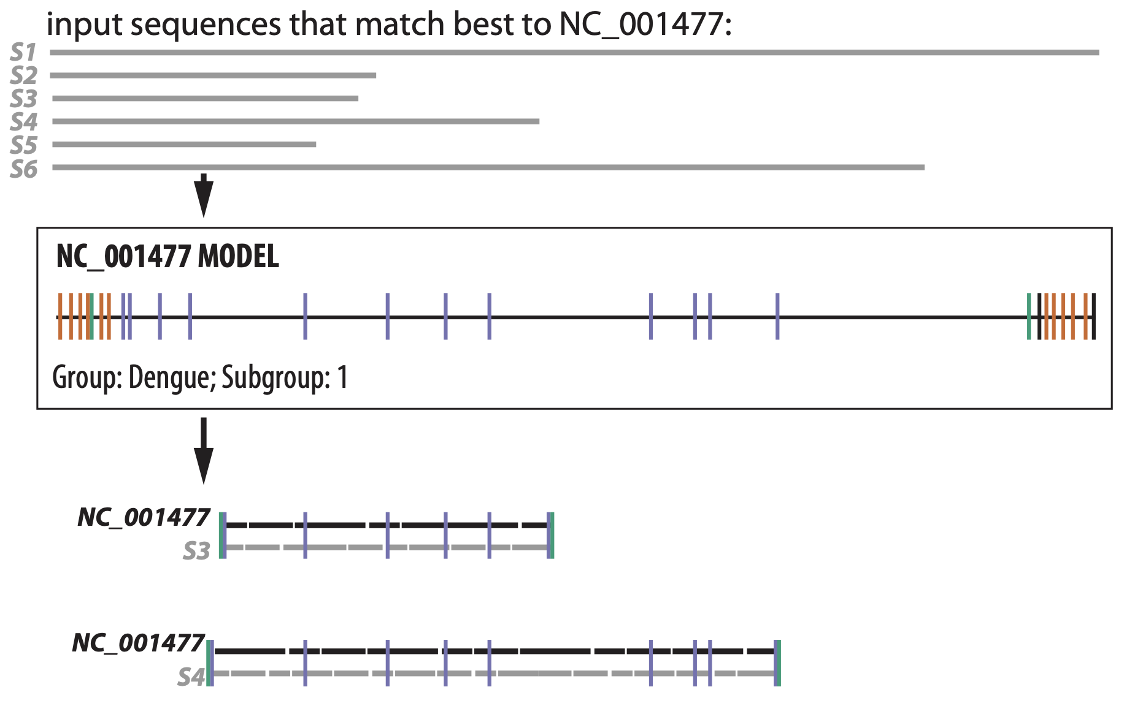
Stage 3: Alignment & feature mapping
Problems caught in coverage determination stage could be missed in alignment stage

Slide 16
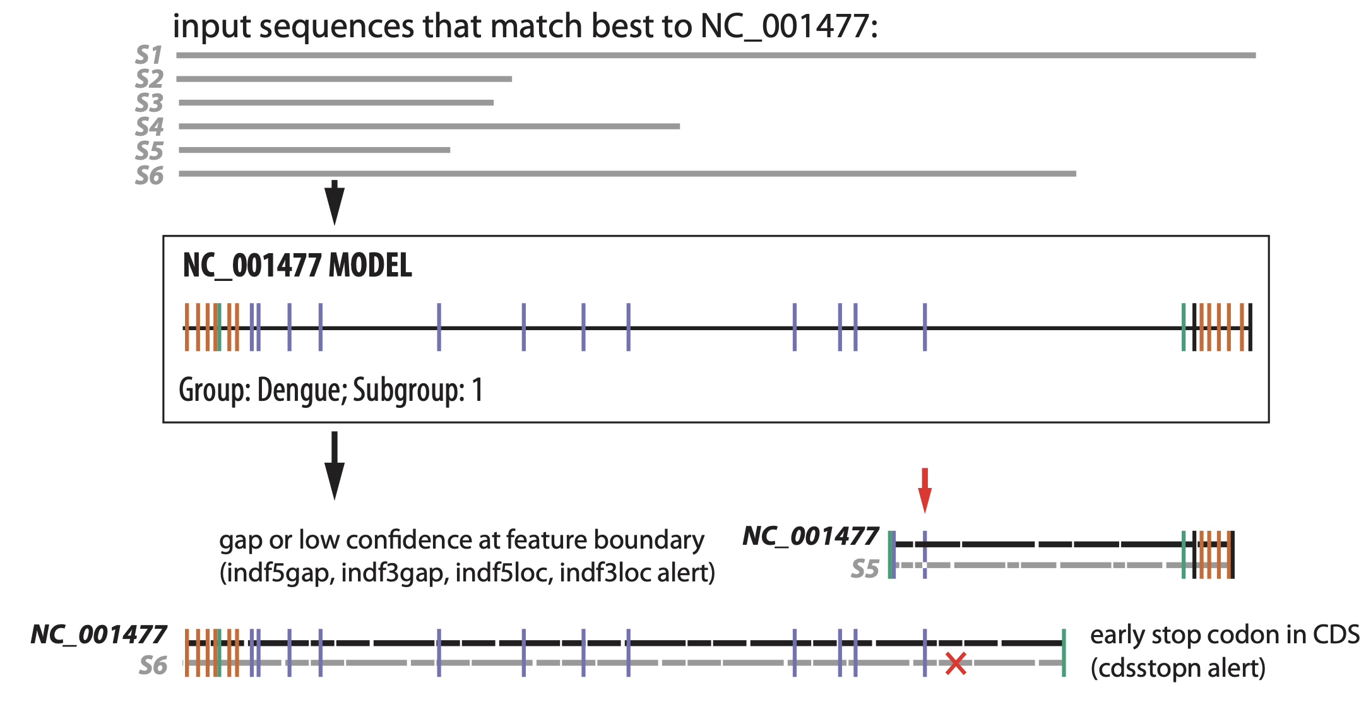
Stage 3: Alignment & feature mapping
Parsing the alignment allows new types of alerts to be detected

Slide 17
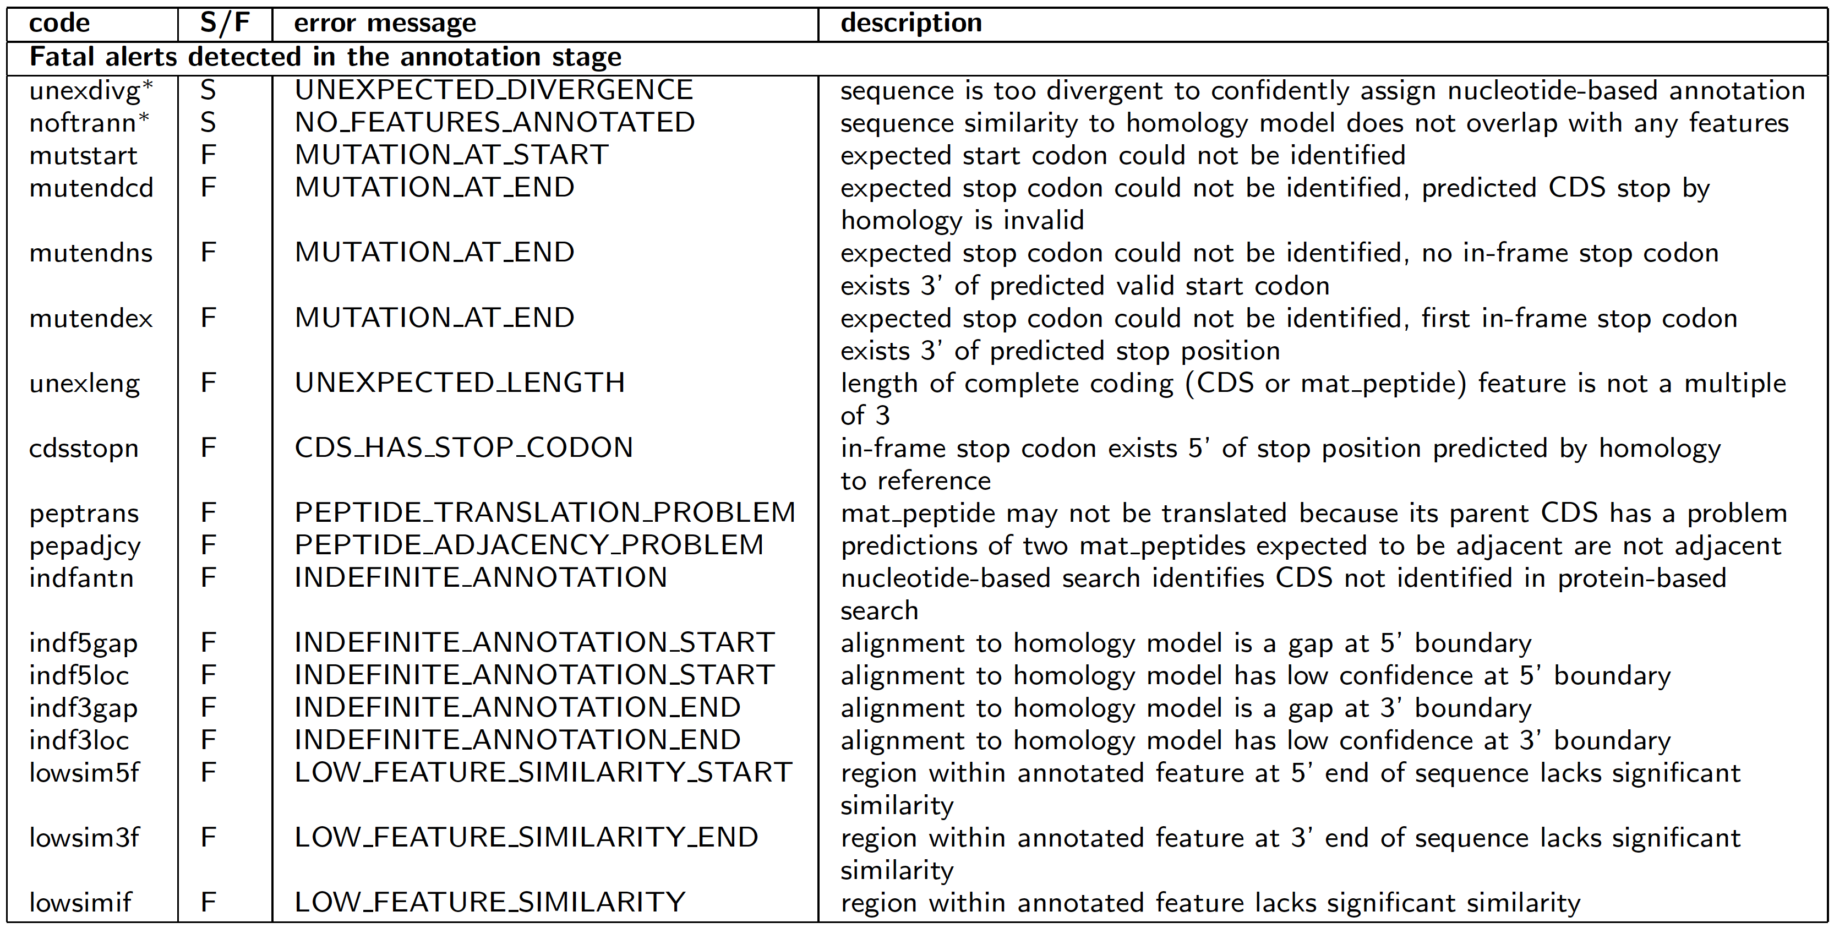
Alerts reported in alignment stage

Slide 18
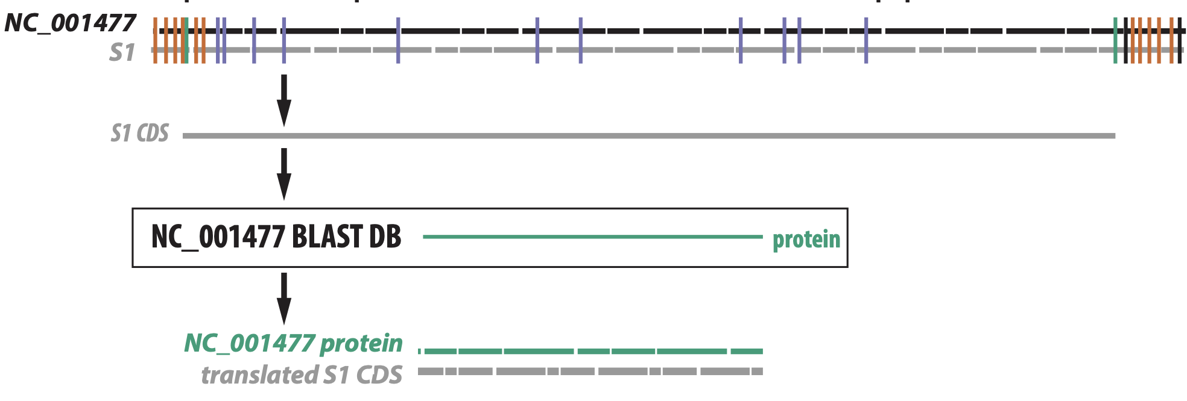
Stage 4: Protein validation (Alejandro Schaffer)
Compare each predicted CDS to model (RefSeq) proteins with BLASTX

Slide 19
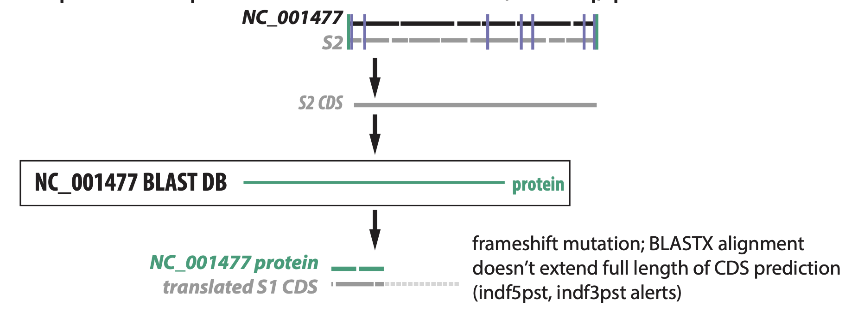
Stage 4: Protein validation (Alejandro Schaffer)
Compare each predicted CDS to model (RefSeq) proteins with BLASTX

Slide 20
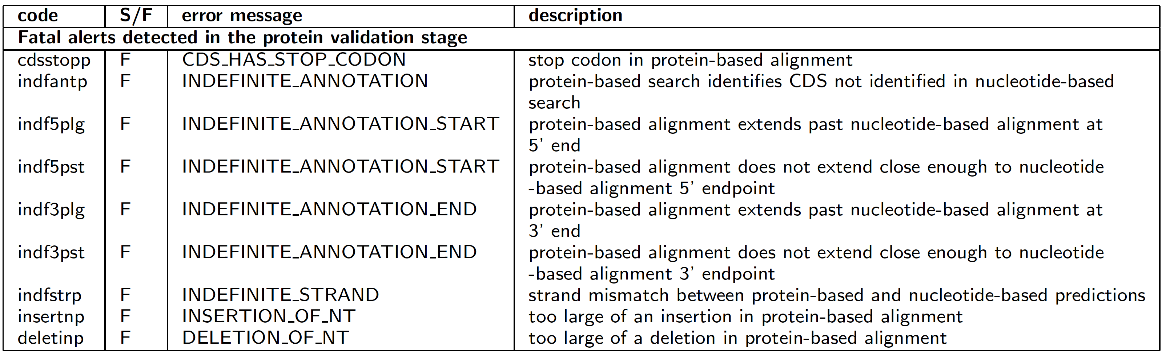
Alerts reported in protein validation stage

Slide 21
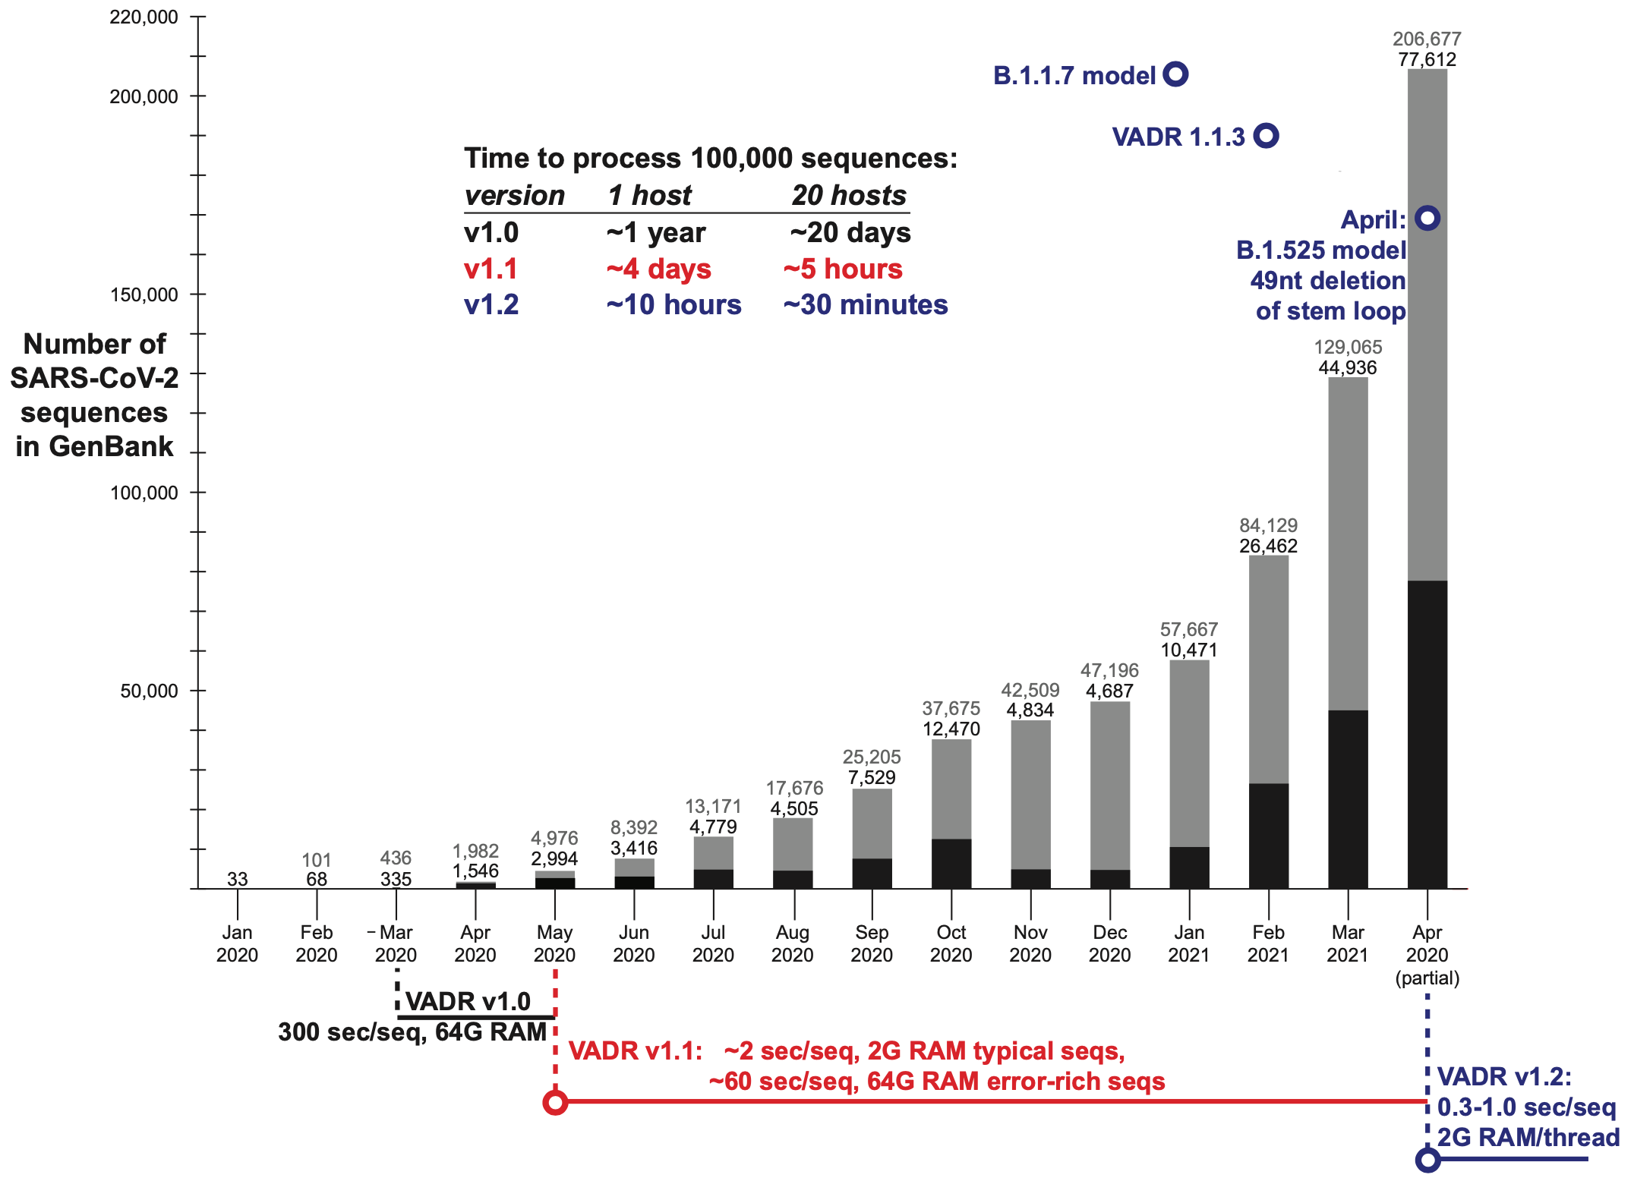
VADR updates for SARS-CoV-2 analysis

Slide 22
Resources and documentation
https://github.com/ncbi/vadr
https://github.com/ncbi/vadr#readme
https://github.com/ncbi/vadr/wiki/Coronavirus-annotation
VADR paper: https://bmcbioinformatics.biomedcentral.com/articles/10.1186/s12859-020-3537-3

Slide 23
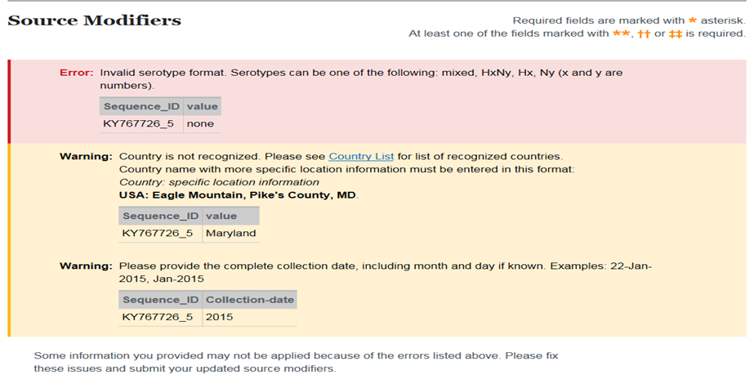
Web submission to GenBank
Forms prompt for required information
Source information imported as table or use of editable table
Interactive source and sequence validation
Country, date, isolate format
Sequence length and vector screening

Slide 24
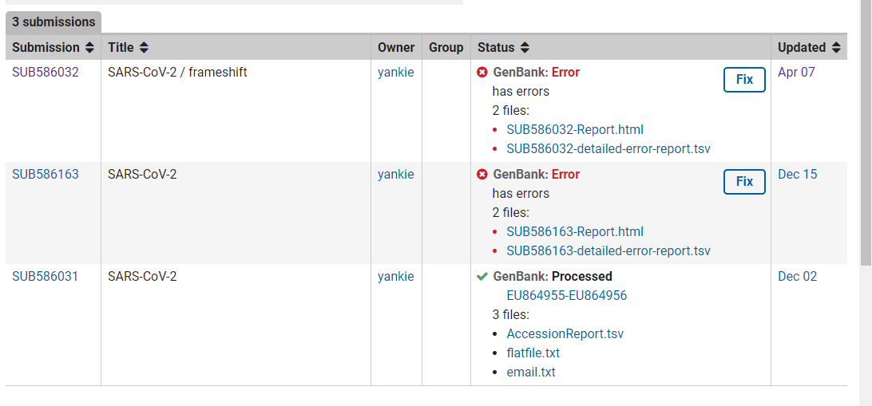
Portal reports

Slide 25
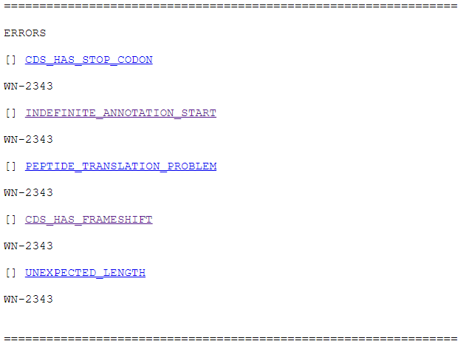
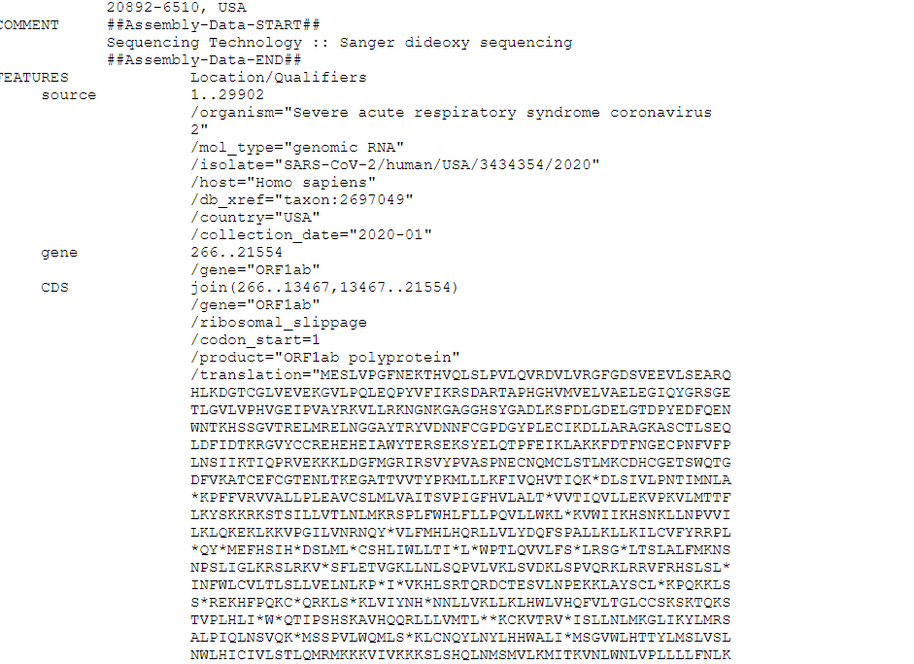
Alert report

Slide 26
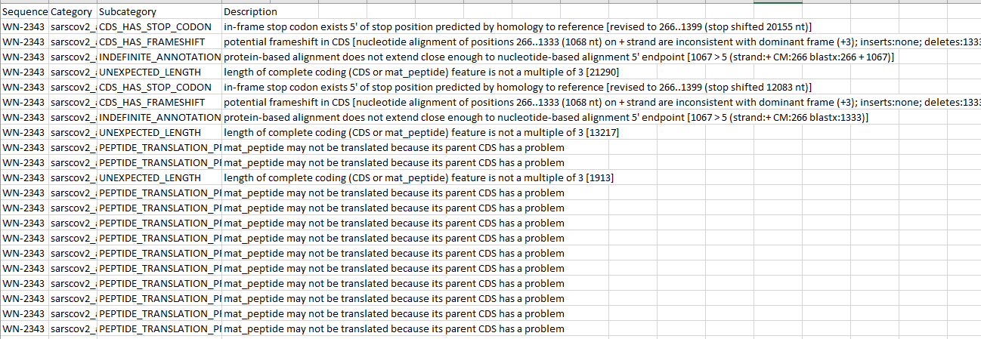
Detailed report

Slide 27
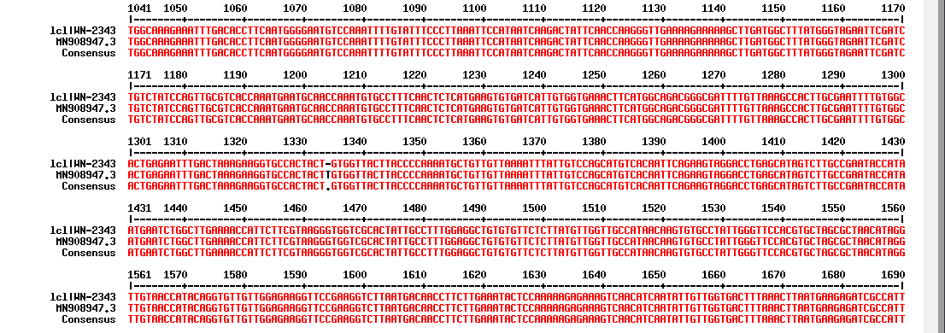
Alignment

Slide 28
VADR alerts on confirmed mutations in nonessential proteins
Write gb-admin@ncbi.nlm.nih.gov
Read coverage over area of mutation
SRR number if not already included
If mutation is common, please let us know!
We can add additional sequences to VADR reference set so future submissions with the same mutation will not produce an alert
Submitter-confirmed mutations in ORF7a, ORF7b, ORF8, ORF3a, ORF6, ORF10

Slide 29
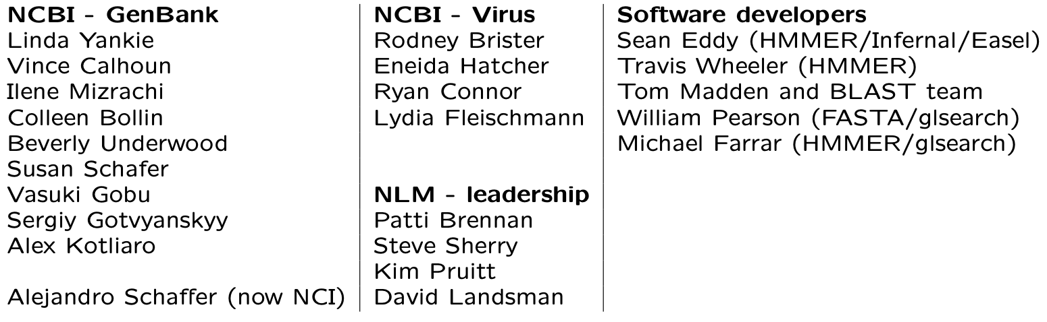
Acknowledgements

